Slide 1
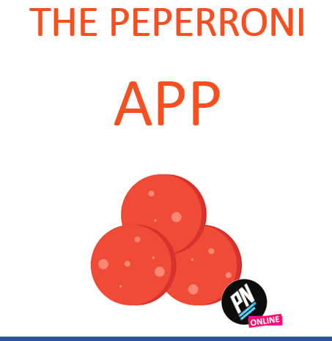

Slide 2

Peperoni app
Required. Shall start with a letter, valid email
Login
Password
Required.
Display starts (*) to hide password
CREATE ACCOUNT
Next

Slide 3
Create Peperoni account
Login
Required. Shall start with a letter, valid email
Password
Required.
Display starts (*) to hide password
Address
Required.
Multi line
If checked the profile will be created as manager
I’m a manager
SIGN IN INSTEAD
Next

Slide 4
Peperoni app
Ronan
******
CREATE ACCOUNT
Next

Slide 5


Logout
And return to
Sign in
Peperoni pizzas !
Sign out
+
Add
Action available
If user
Is manager
Name
Ingredients
Prize
Jack Pizza
Tomatoes, ham, cheese, peperoni
15 $
Rady Pizza
Rice, rice, rice
1 $
Actions available
If user
Is manager
Ronan Pizza
French cheese, Italian cheese, coconut
21 $

Slide 6
Peperoni pizzas !
Sign out
Edit pizza
+
Add
Jack Pizza
Name
Ingredients
Prize
Jack Pizza
15
15 $
Tomatoes, ham, cheese, peperoni
Rady Pizza
Rice, rice, rice
1 $
Cheese
Tomatoes
Ronan Pizza
French cheese, Italian cheese, coconut
21 $
DISCARD
UPDATE

Slide 7
Create pizza
Required. Shall start with a letter
Name
Prize in dollars
Required. Shall be number between 1 to 50 dollars
Ingredients
Optional
Free text on many lines
DISCARD
CREATE

Slide 8


USE CASES DIAGRAM
Create account
Customer
View pizzas
Manage pizzas
Manager

Slide 9
INTERACTION DIAGRAM
Sign in view
Pizza view
Next
Sign out
Sign up view
Next
Create account
Sign in instead

